Slide 1
CRE Intervention Result visualization
2025.06.20

Slide 2
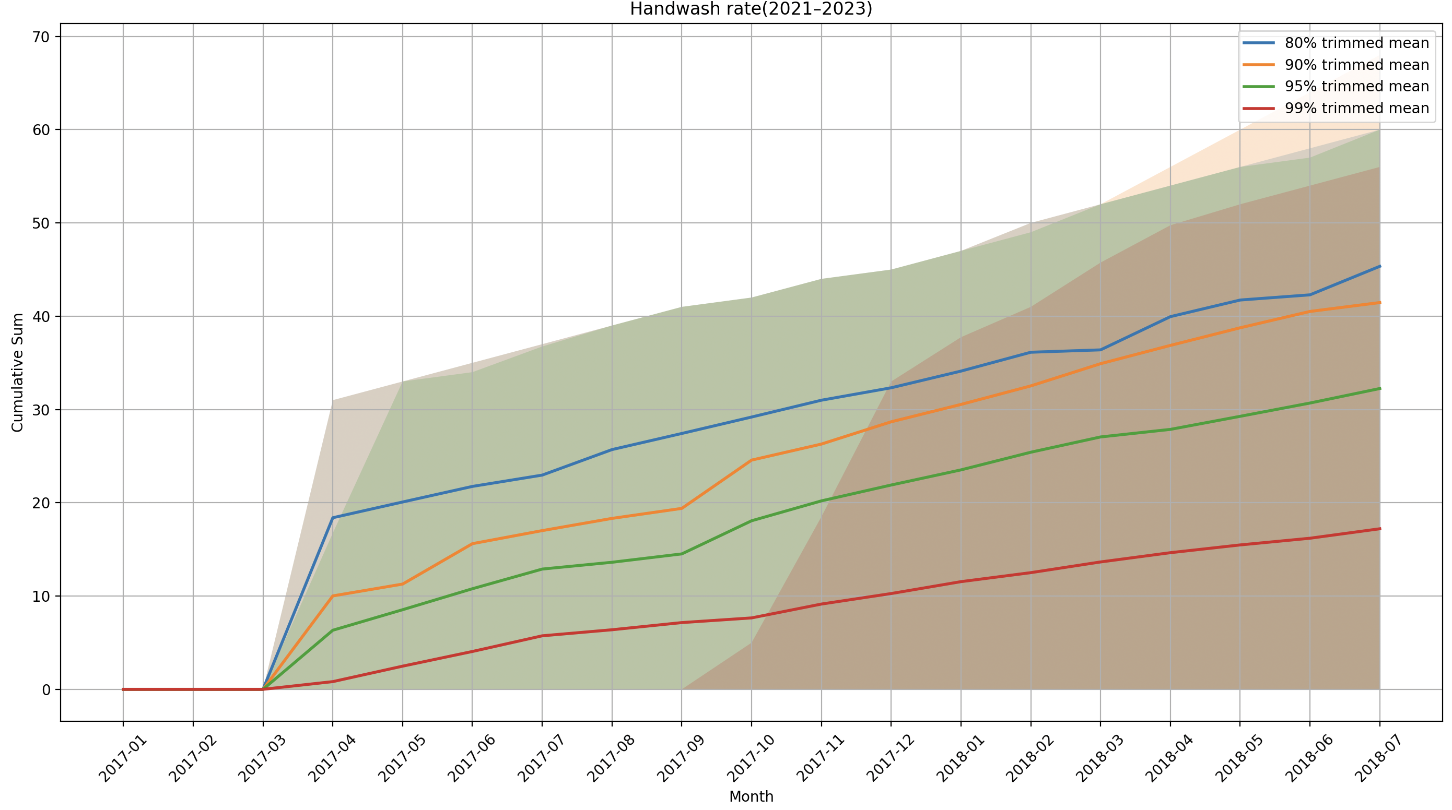
Handwash rate (2017-2018)

Slide 3
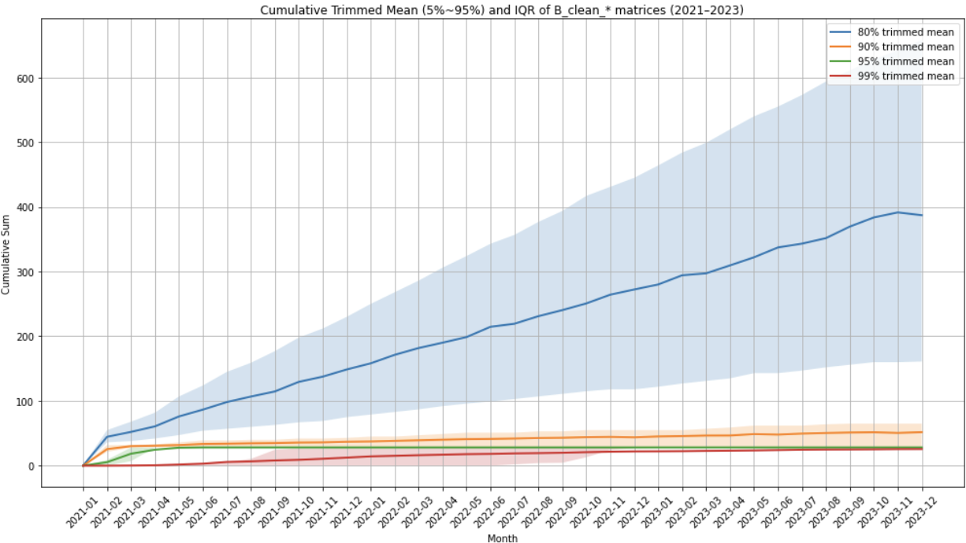
Handwash rate (2021-2023)

Slide 4
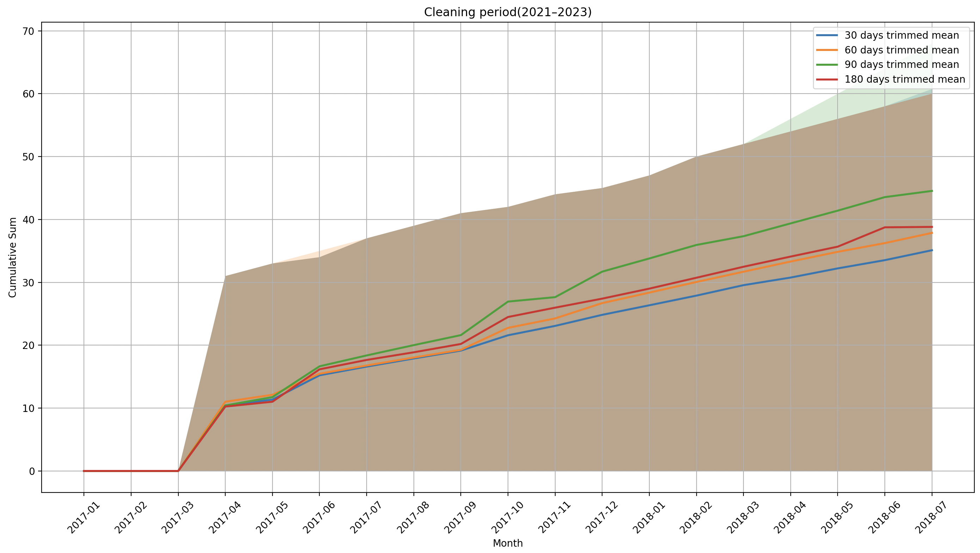
Cleaning Period (2017-2018)

Slide 5
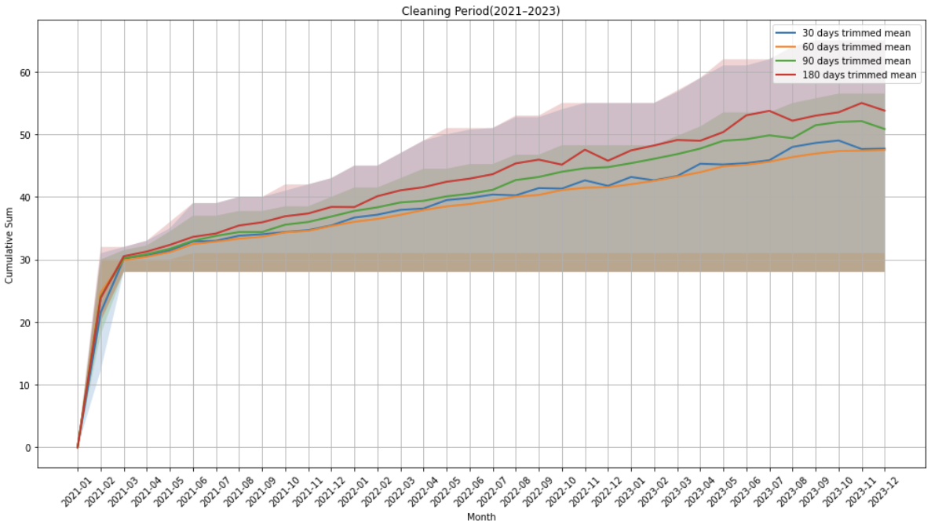
Cleaning Period (2021-2023)

Slide 6
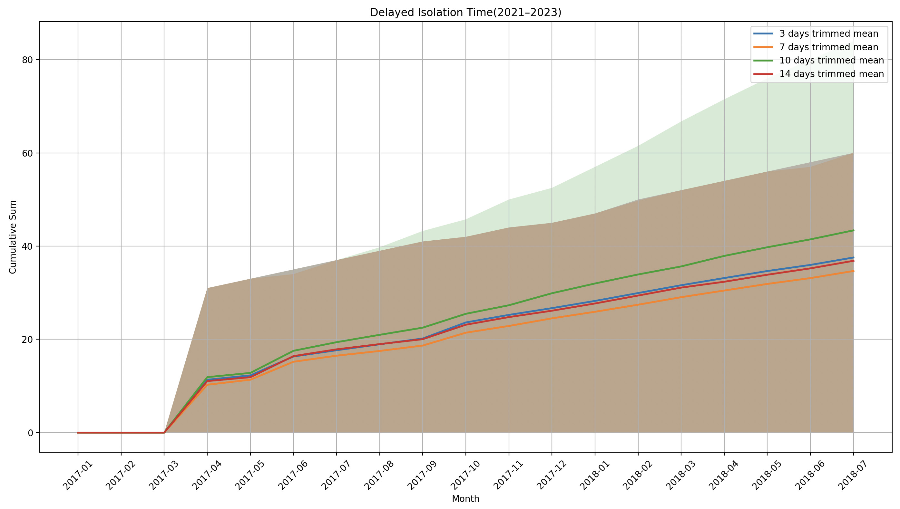
Delayed Isolation Time (2017-2018)

Slide 7
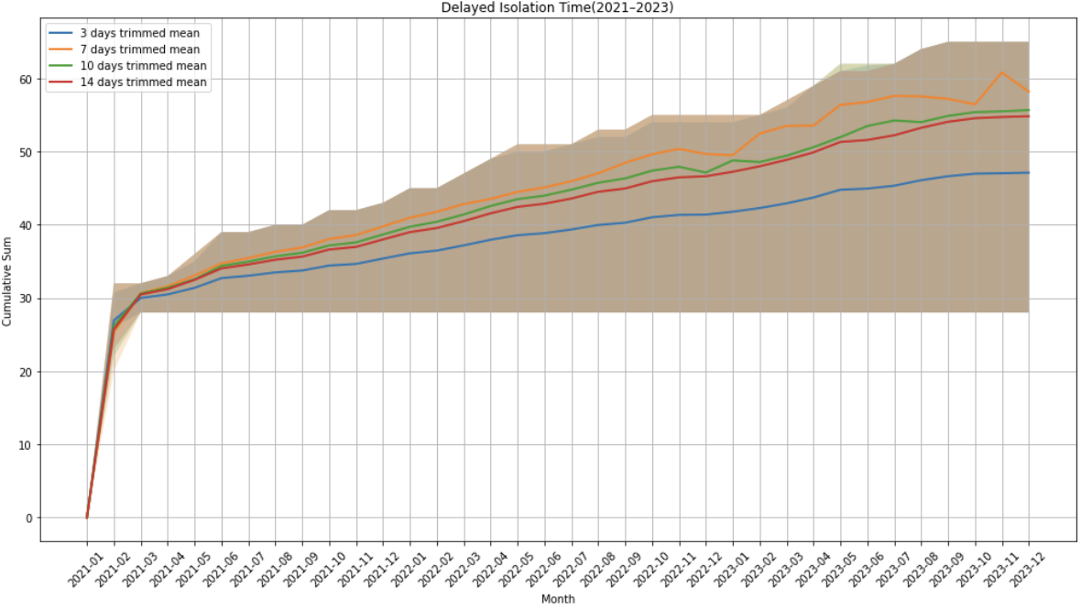
Delayed Isolation Time (2021-2023)

